Slide 1
Analysis of Runs 18413
Details of connections related to this run:
Channel 24 Silica fiber and Channel 23 PMMA
Run 18413 is 24 hrs
Run 18413 – no thermal control (refer elog:170)

Slide 2
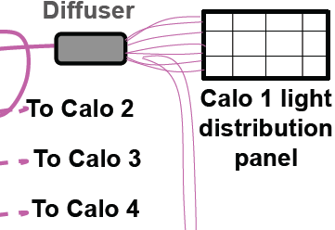
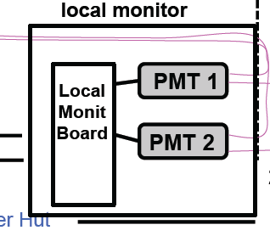
LM (after discussion with INO Colleagues)
Foward
A2=L*F*B, F= forward eff; B=Bacw eff
IF F Gain Sipm should be corrected; IF B no
R=A2/A1 ← most of the effect due to F → apply to Gain corr
DR=R_PM1/R_PM2 sensitive to B1/B2 (no to Gain corr)
Backward
A2
Fibra quarzo
WFD g-2 (scheda “Corradi”)
Local DAQ (scheda “Napoli”) & eventualmente ai WFD g-2
Fibra PMMA

Slide 3
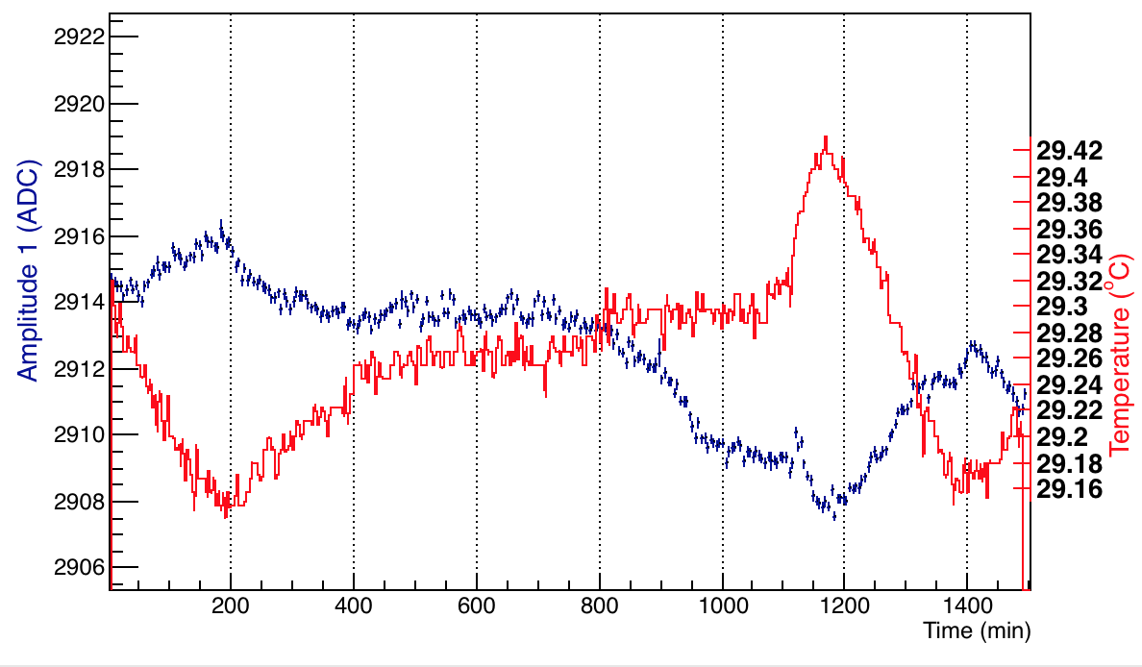
Temp dependence on A1 – Channel 23
Channel 23, Amplitude 1
Run 18413

Slide 4
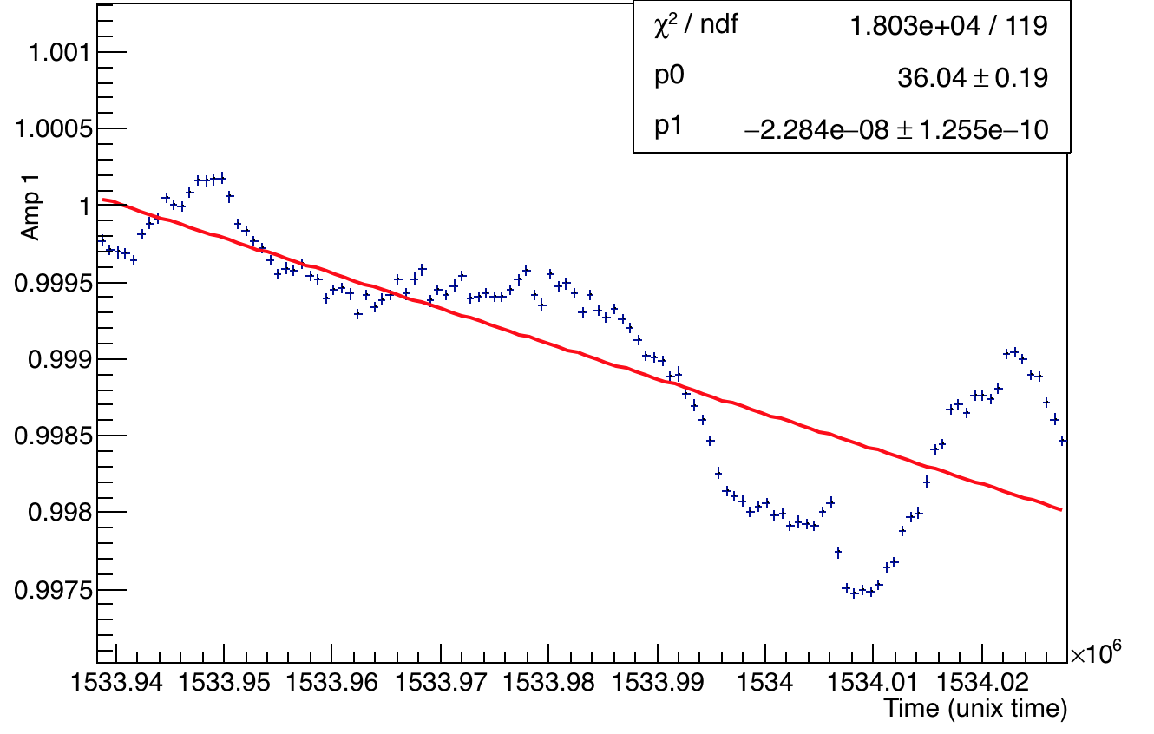
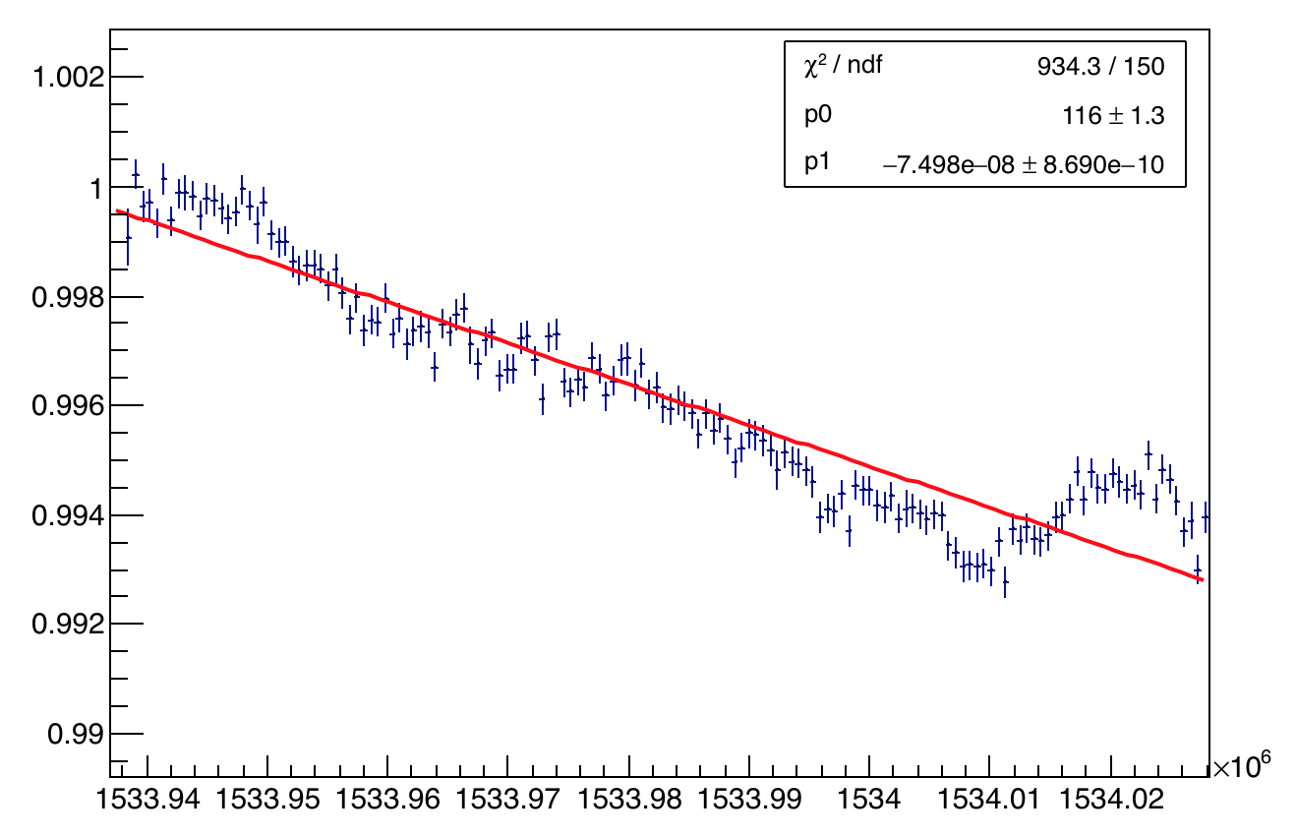
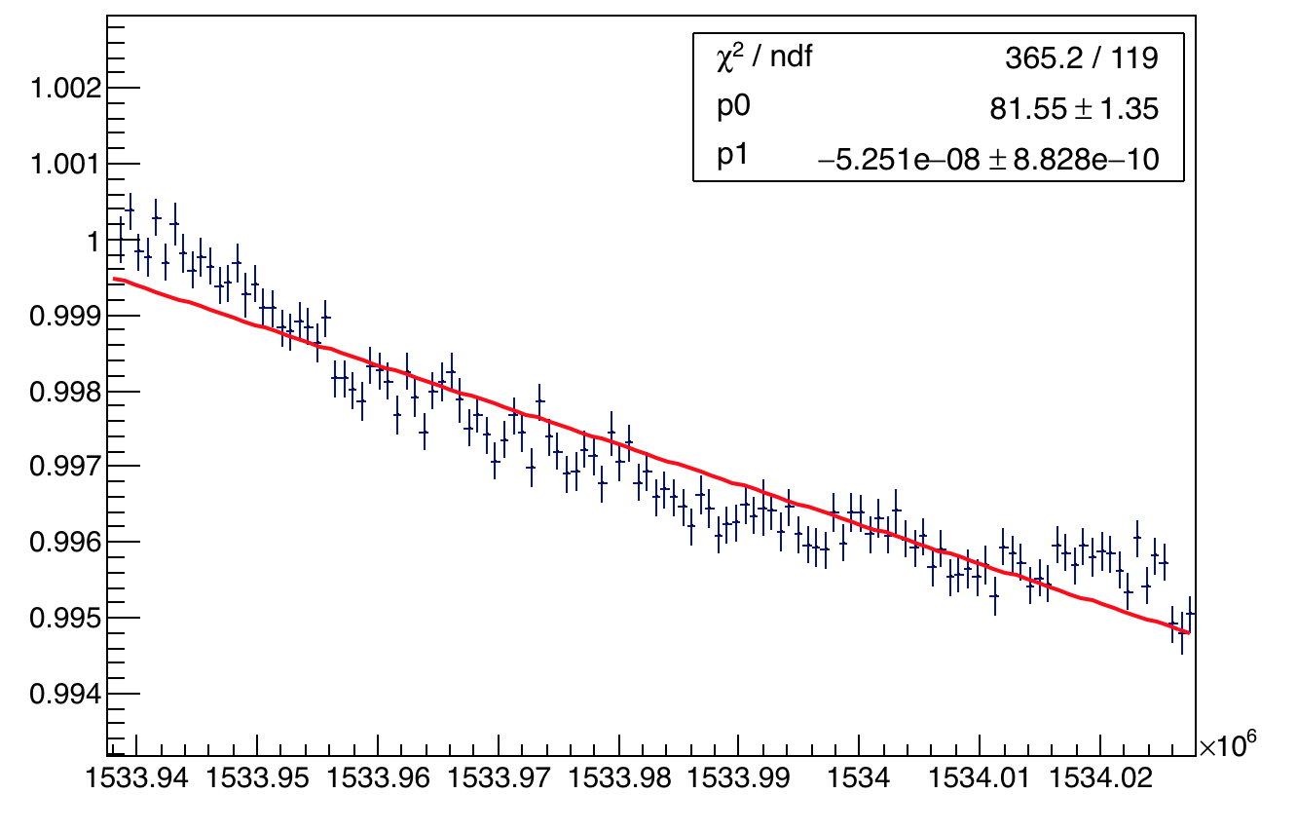
Channel 23 PMMA - amplitudes
A1
A2
Run 18413
A2:A1
Normalized by the value of first bin

Slide 5
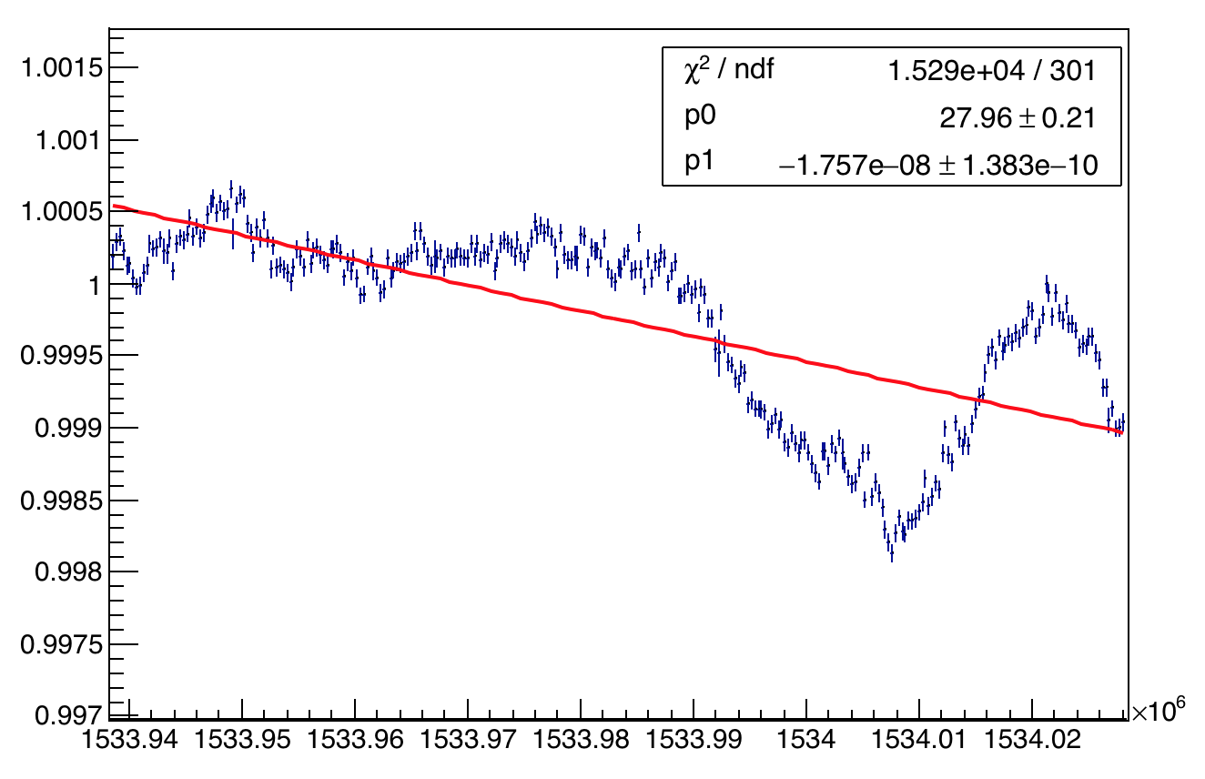
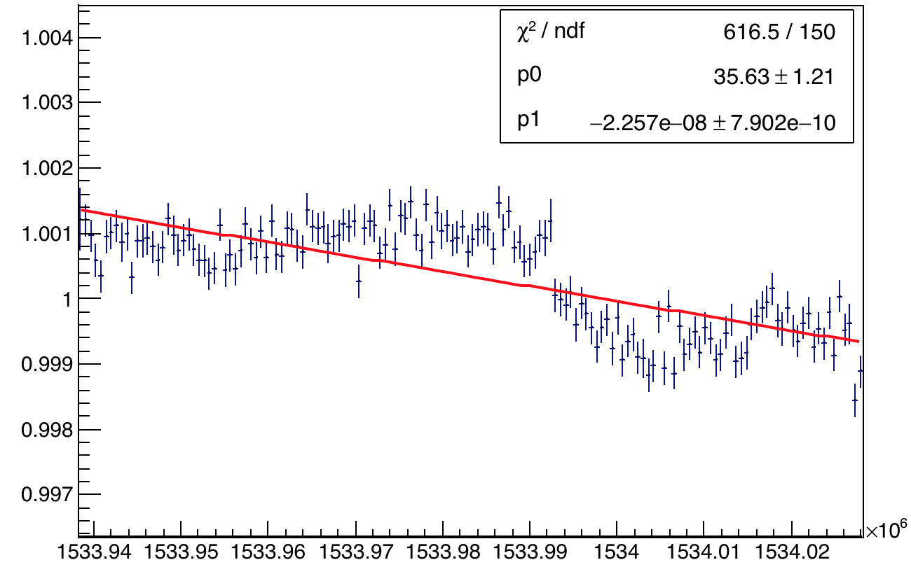
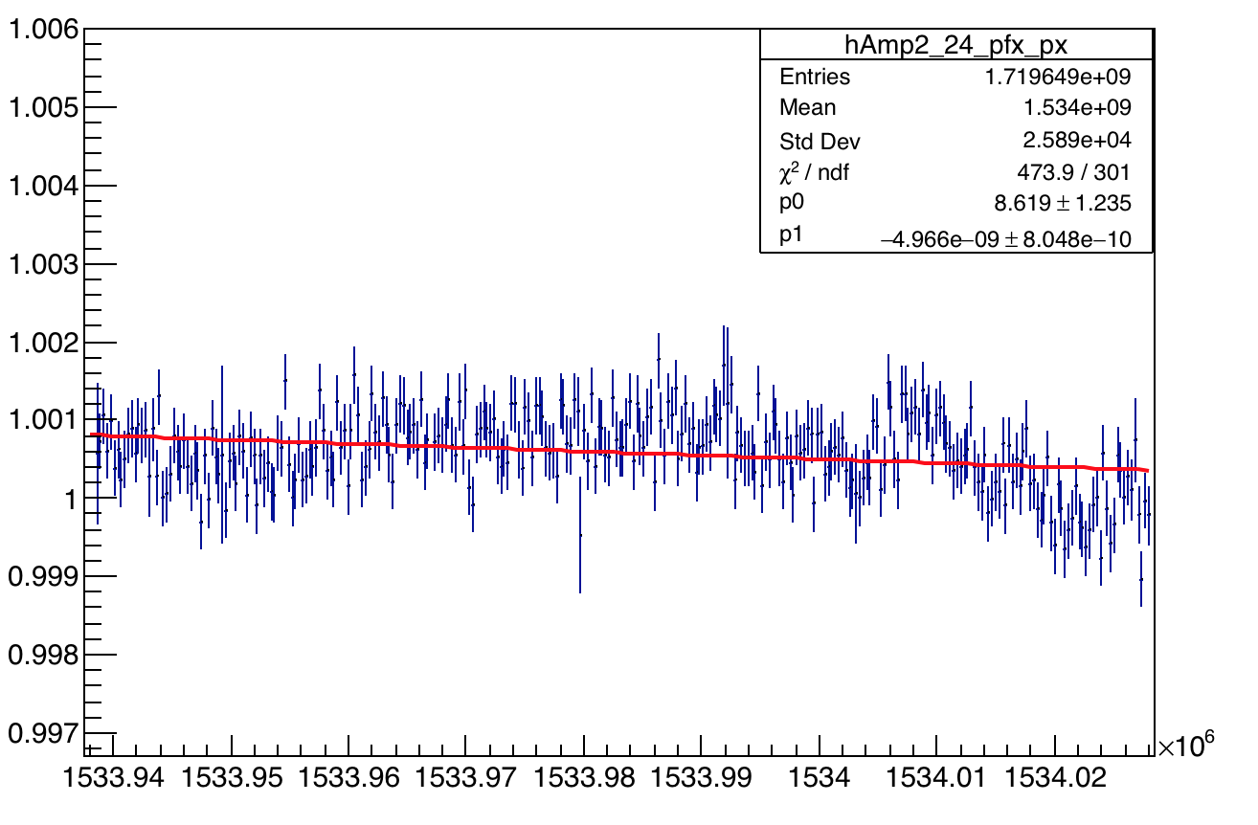
Channel 24 Silica - amplitudes
A1
A2
Run 18413
A2:A1
Normalized by the value of first bin

Slide 6
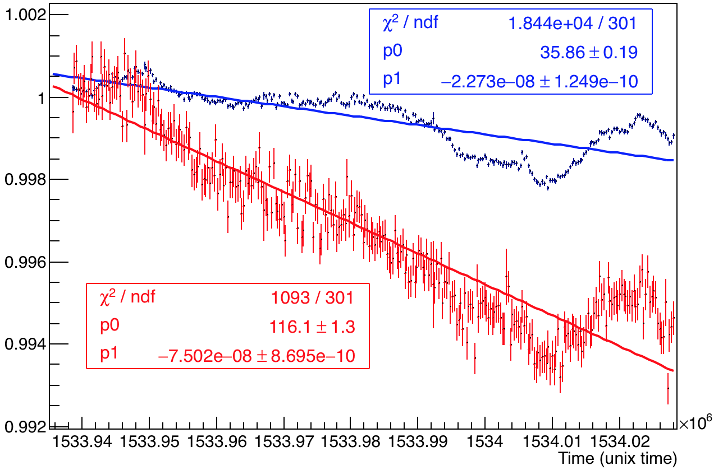
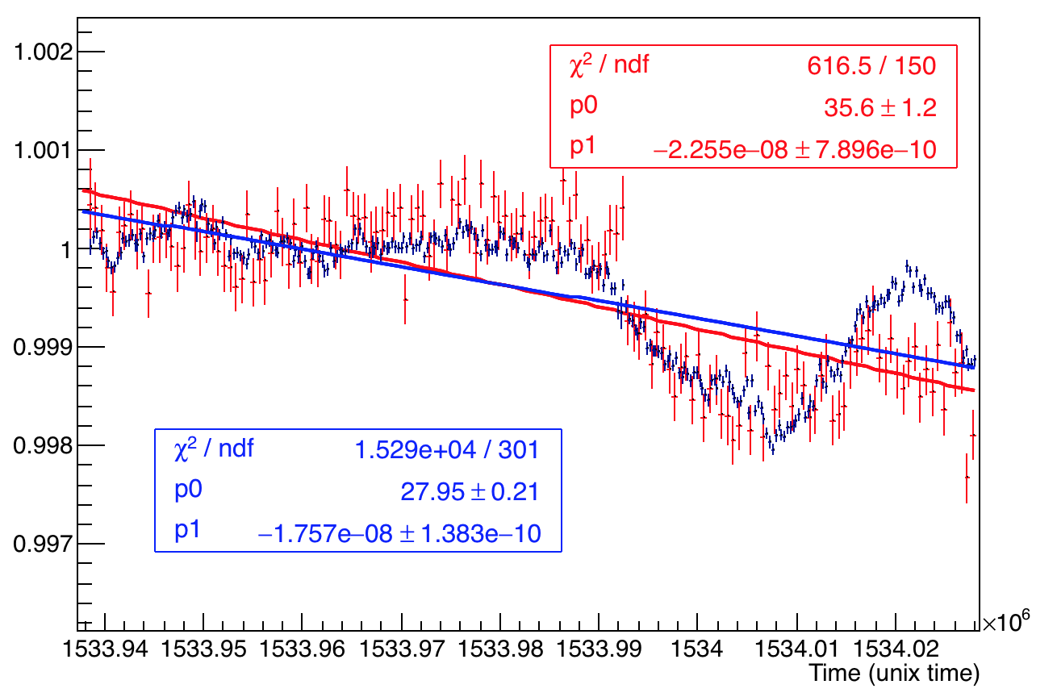
Comparing A1 and A2
A1
A2
PMMA Channel 23
A2
Run 18413
Normalized by the mean of first 5 bins
A1
Silica Channel 24

Slide 7
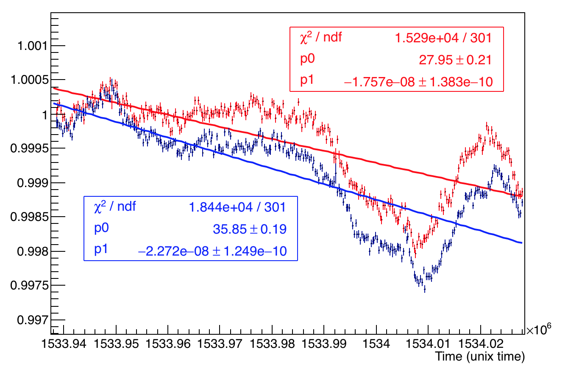
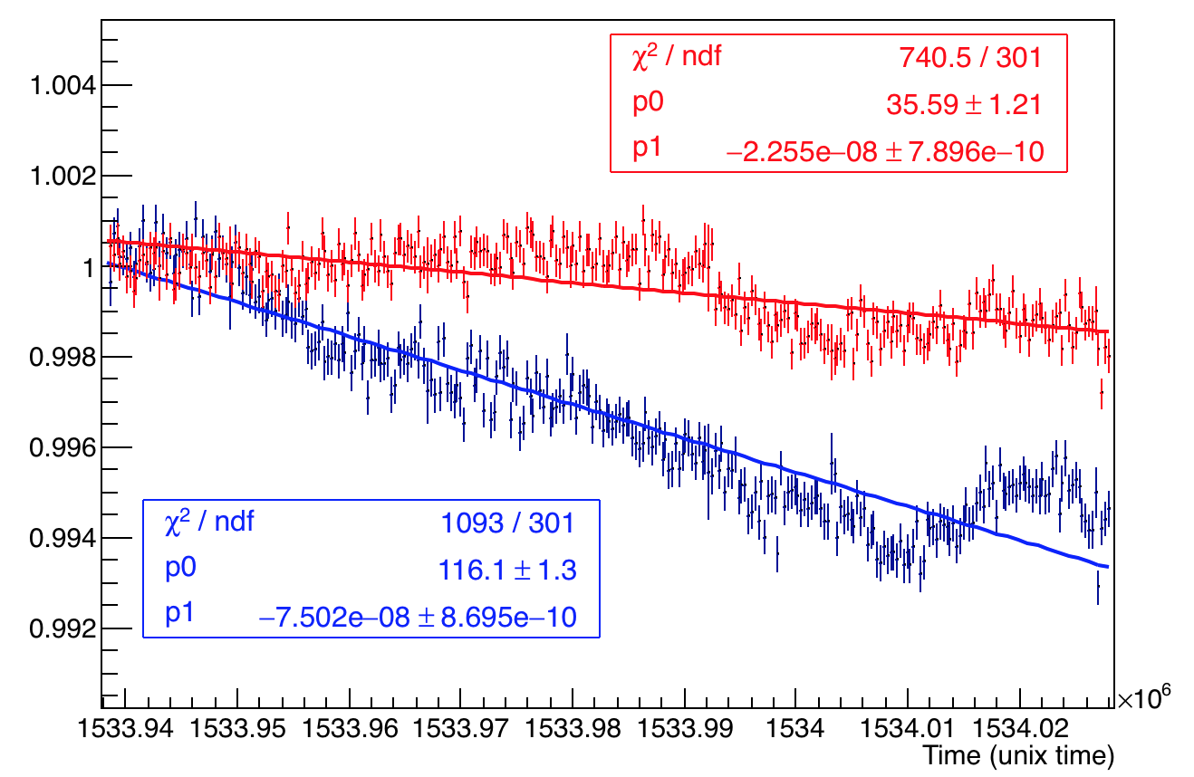
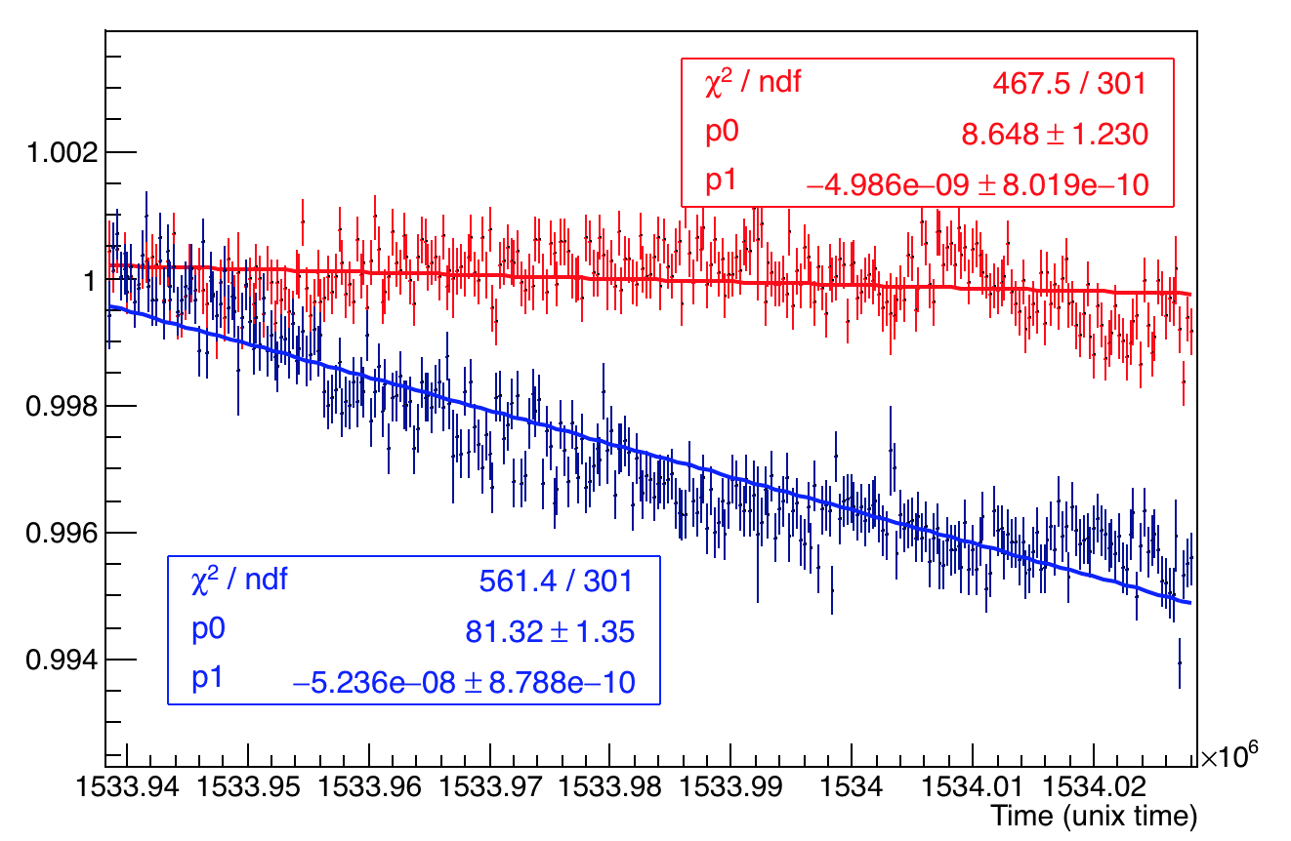
Comparing channel 23 and 24
A1
A2
Run 18413
Normalized by the mean of first 5 bins
A2:A1

Slide 8
Conclusions
A1 primarily indicates the gain fluctuation of the PMT, as it is directly connected to the PMT from SM using a silica fiber. As expected (Slide 3) negative correlation with temperature (PMT gain). Slide 7 shows that A1 is similar for channels 23 and 24.
A2 can have additional effects in fluctuation due to forward and reverse fibers to and from the calorimeters respectively. For silica no visible effects on A2 (behind Gain variation), Slide 5.
For PMMA "strange" and significant drop behind Gain variation (Slide 4). No explanation at the moment.
In any case LM correction should be applied only if variation happens in the forward direction.

Slide 9
Back Up Slides – Studies of run 18422 and Temperature studies

Slide 10
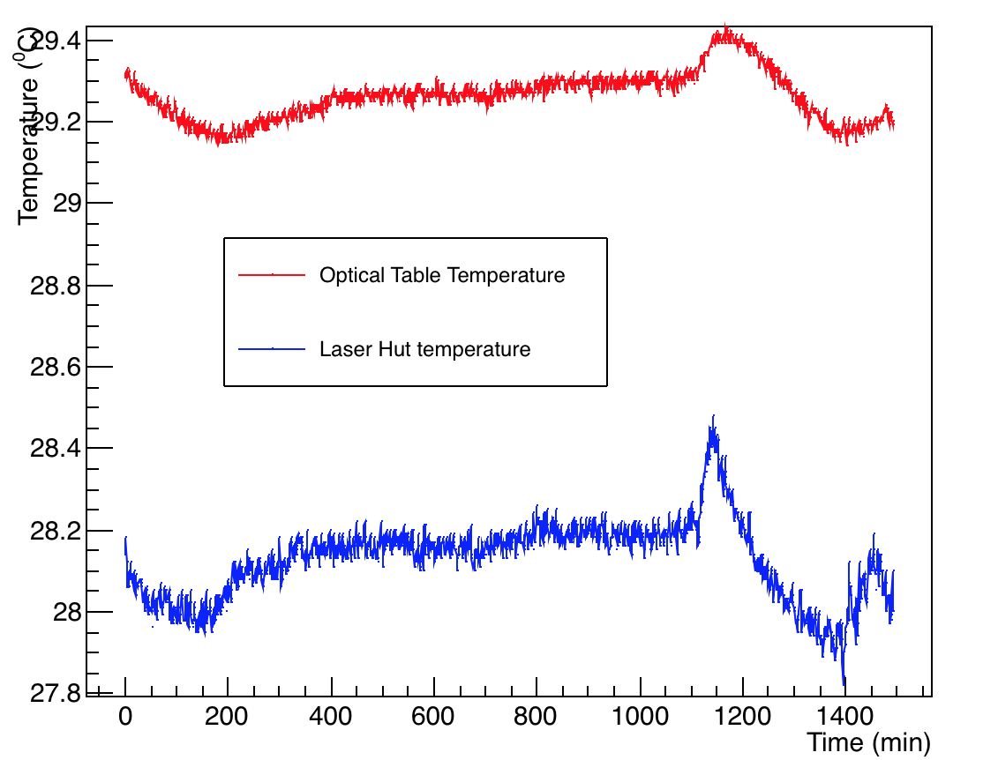
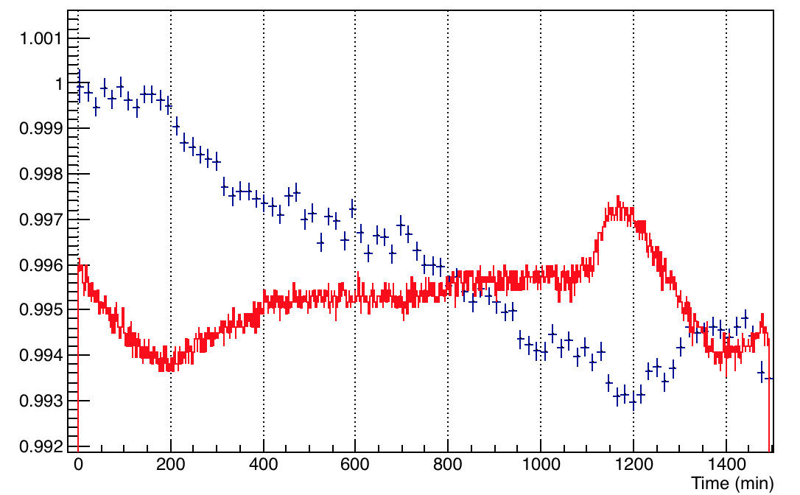
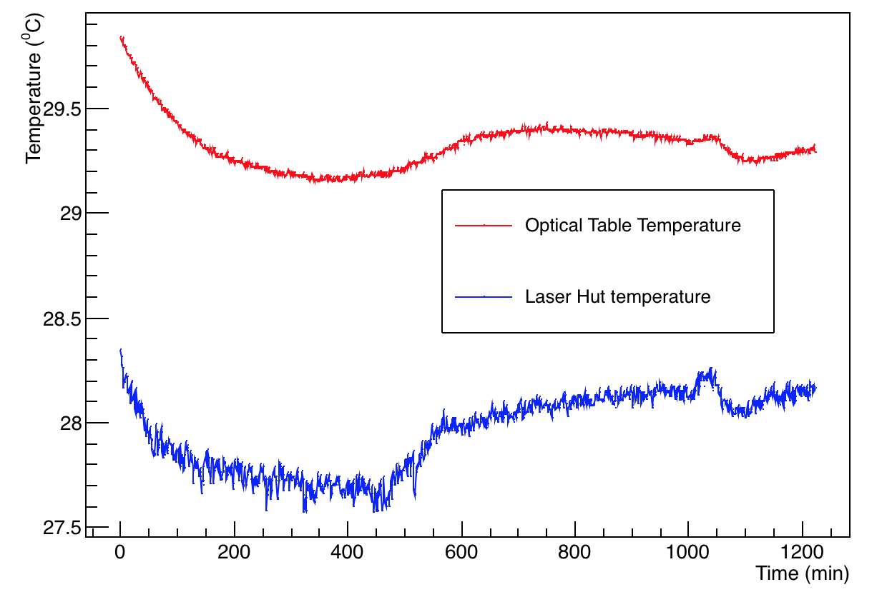
Temp plots
Run 18413
A2 and Temp
Run 18422

Slide 11
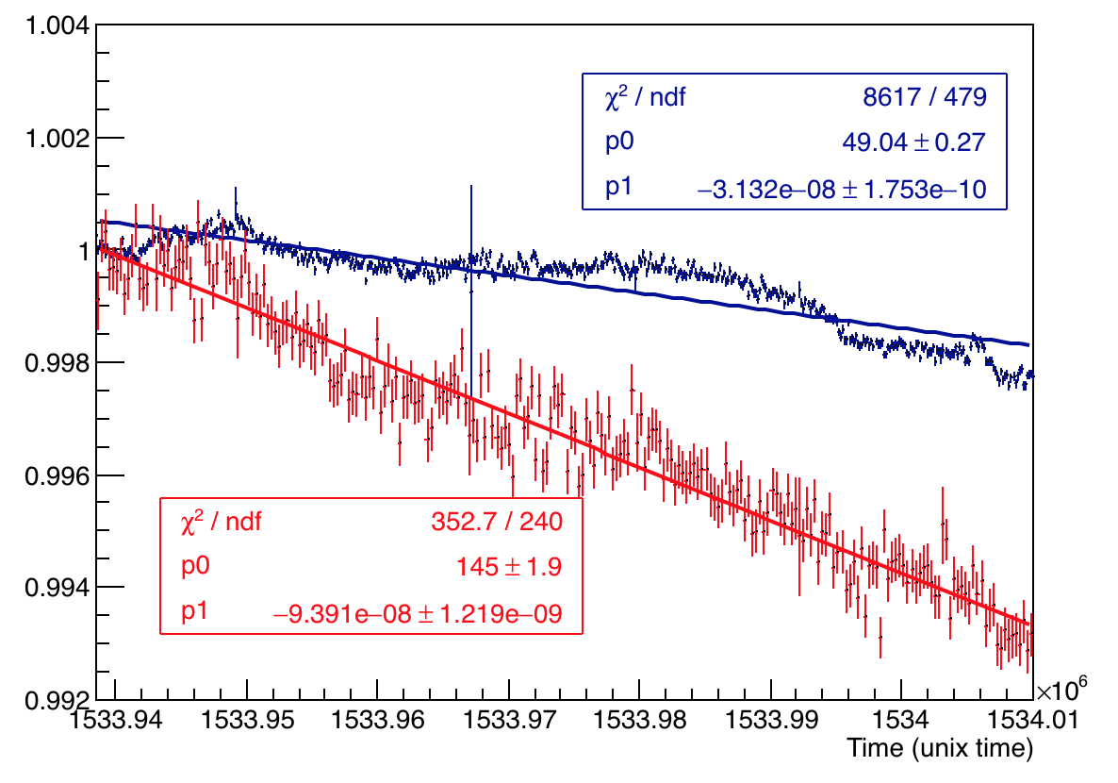
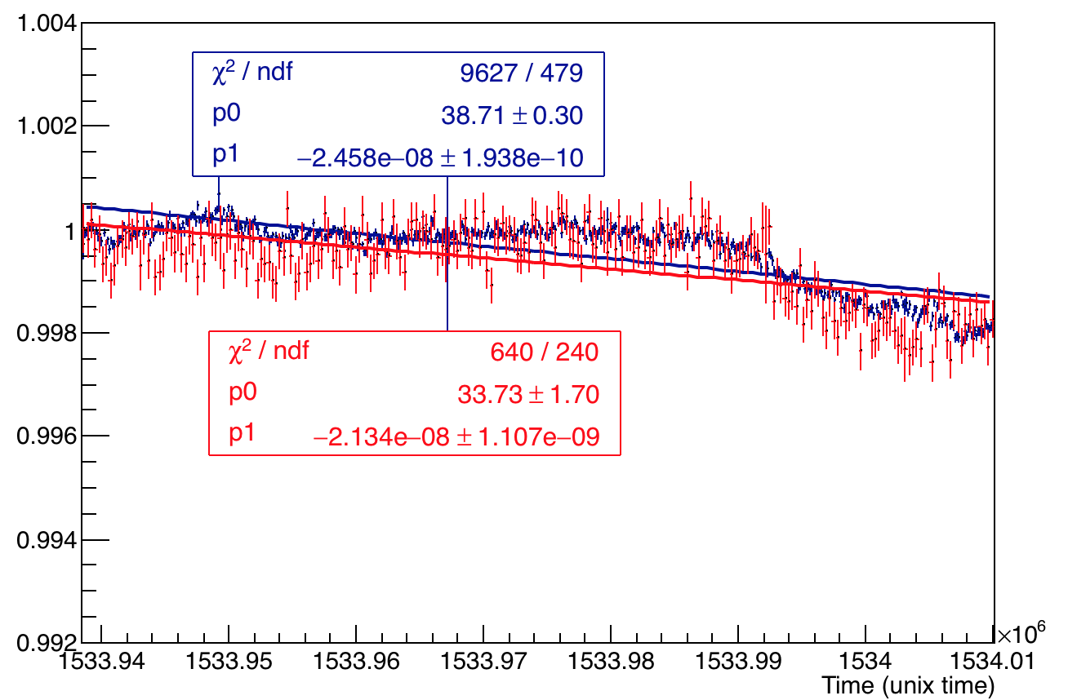
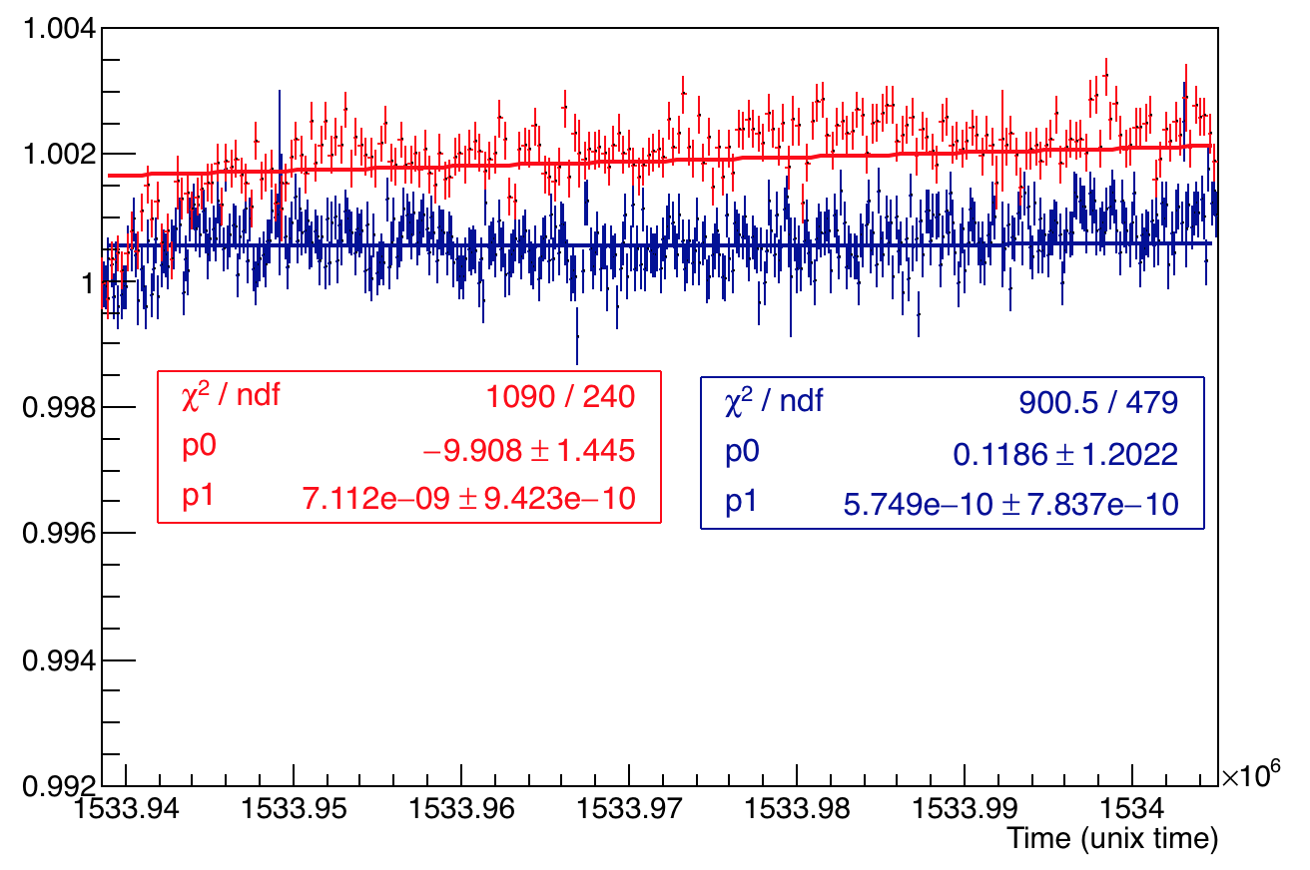
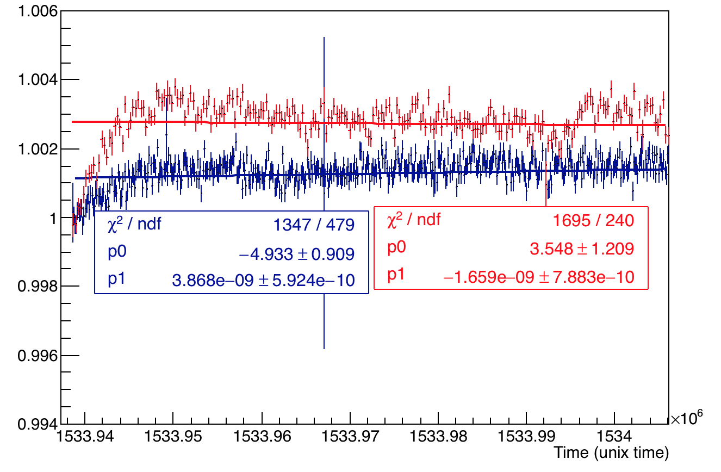
Checking all channels A1 and A2 overlaid
PMMA Channel 23
Silica Channel 24
Channel 0
Channel 1

Slide 12
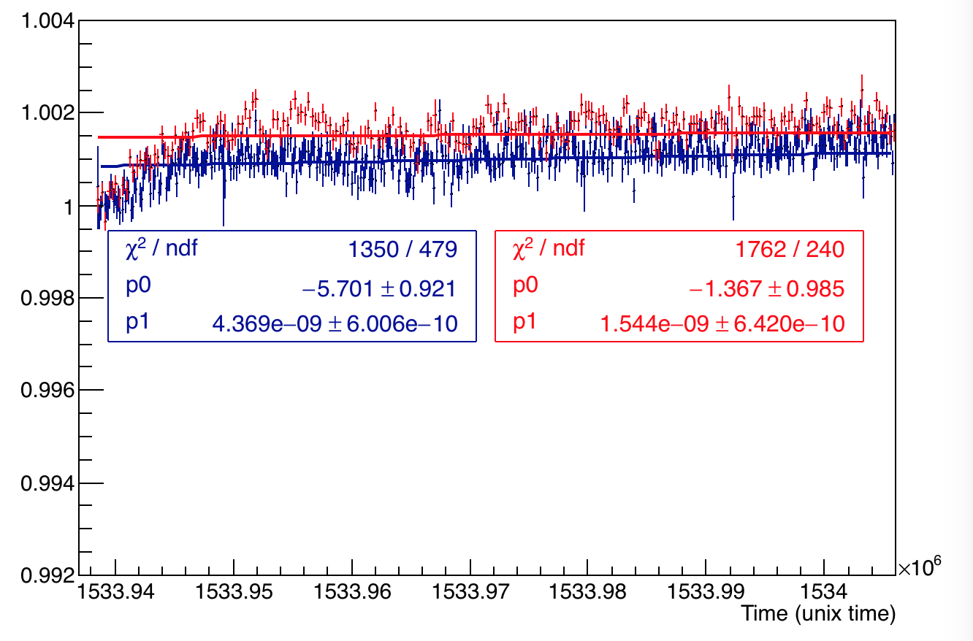
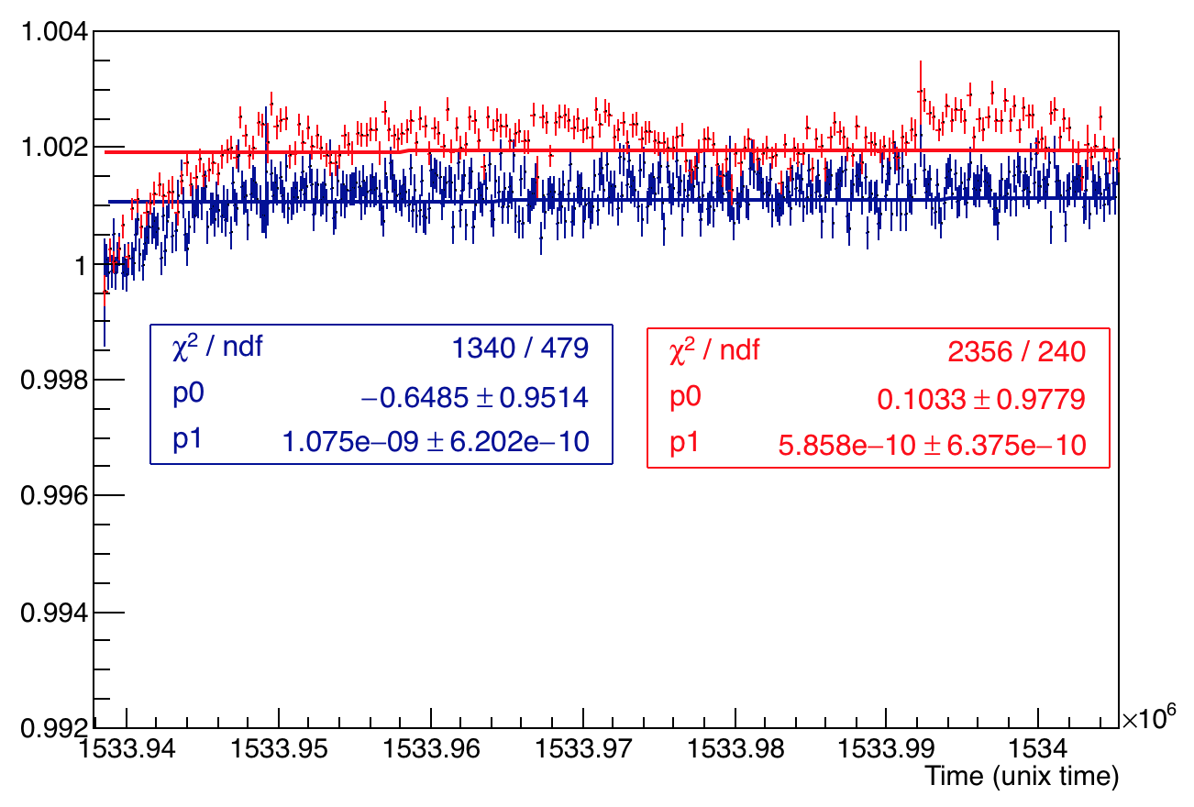
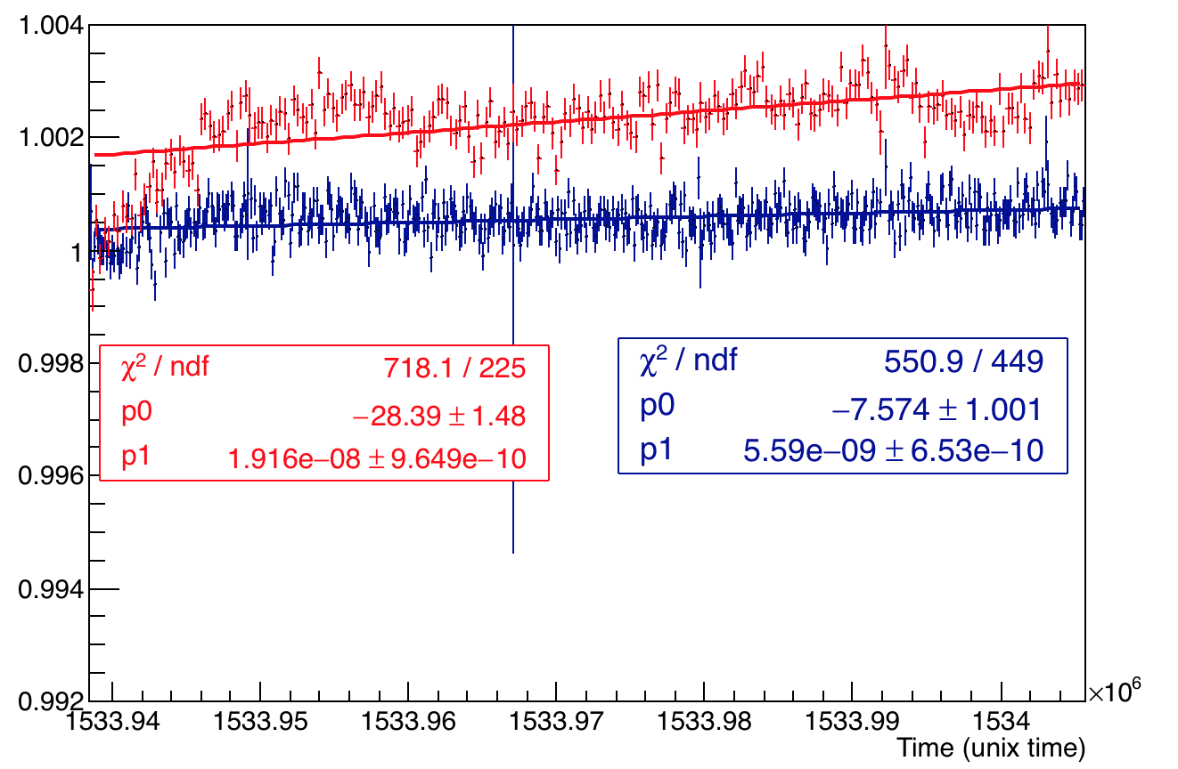
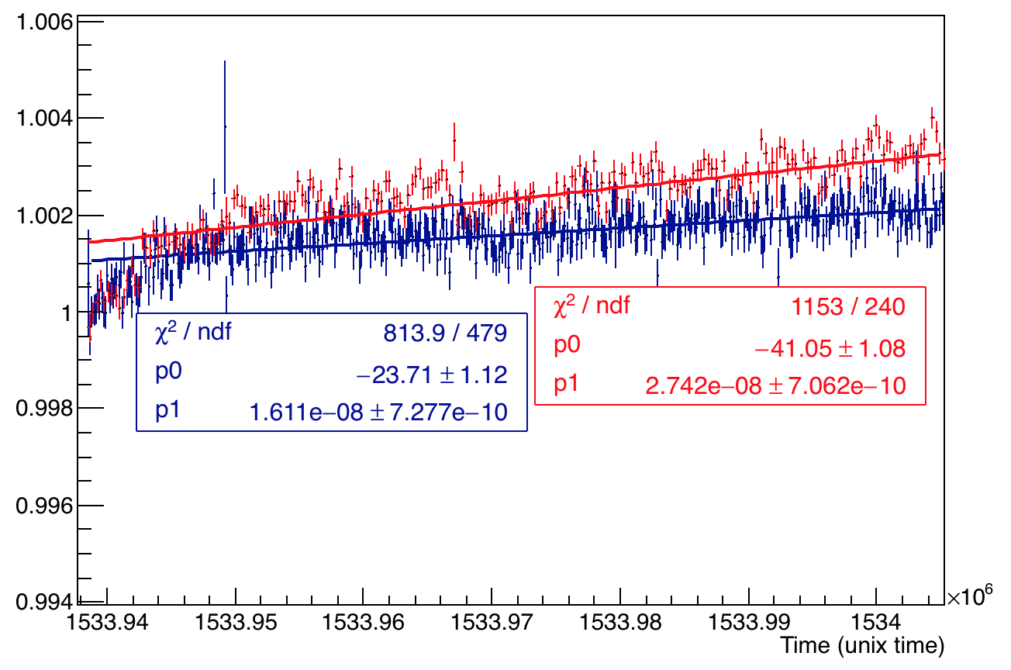
Checking all channels A1 and A2 overlaid
Channel 2
Channel 3
Channel 4
Channel 5

Slide 13
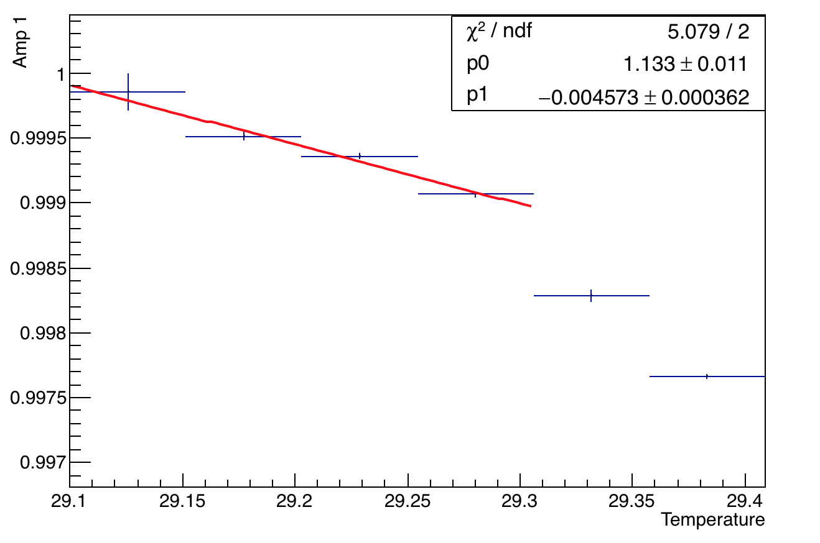
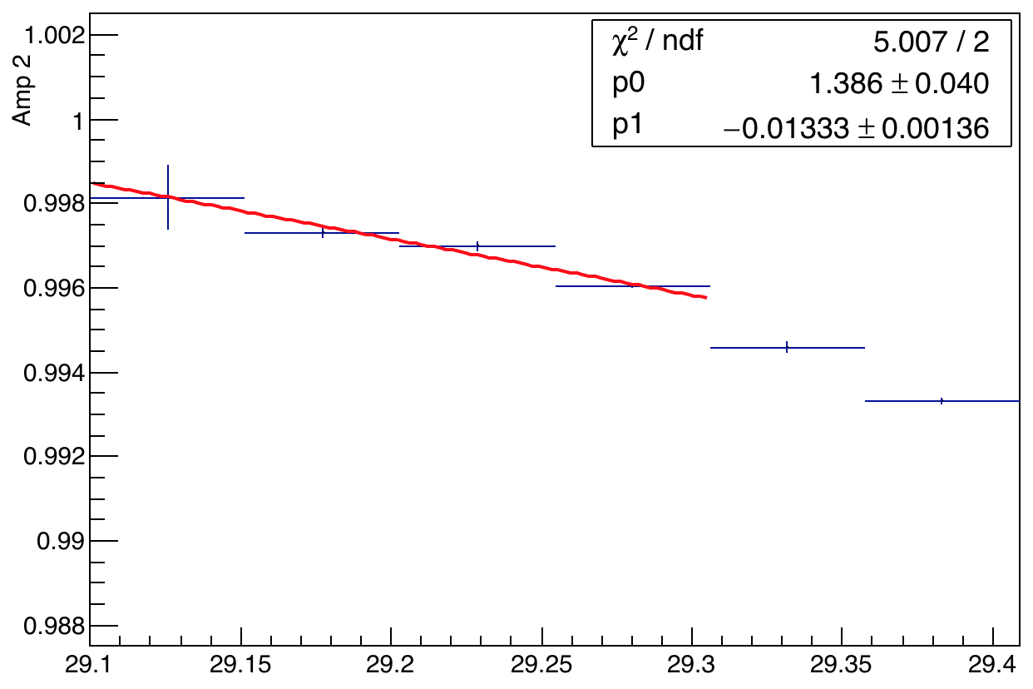
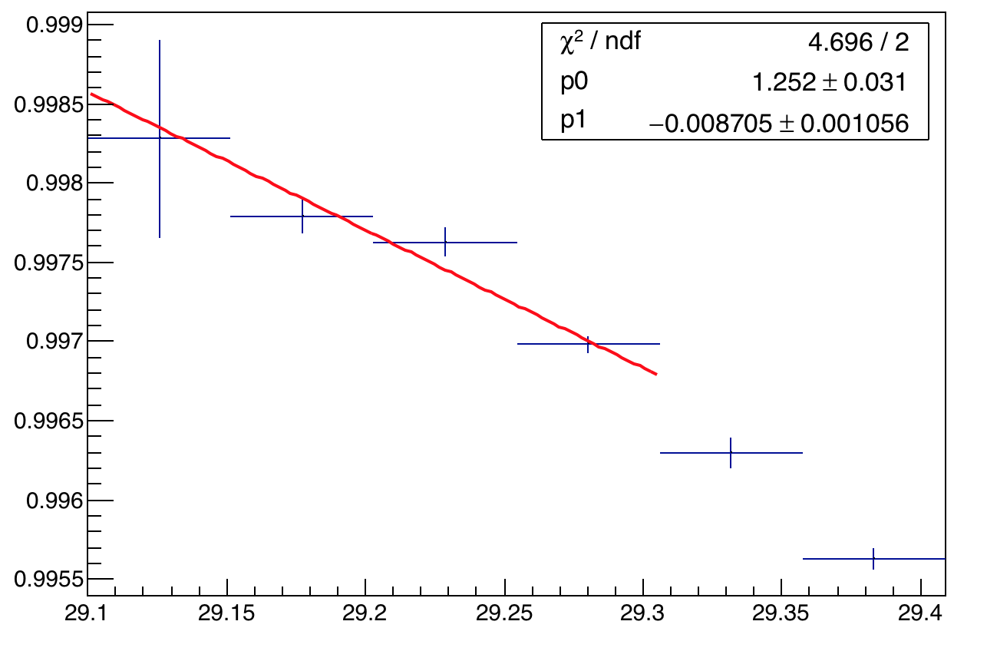
Channel 23 – Variation with temp
A1
A2
Run 18413
A2:A1

Slide 14
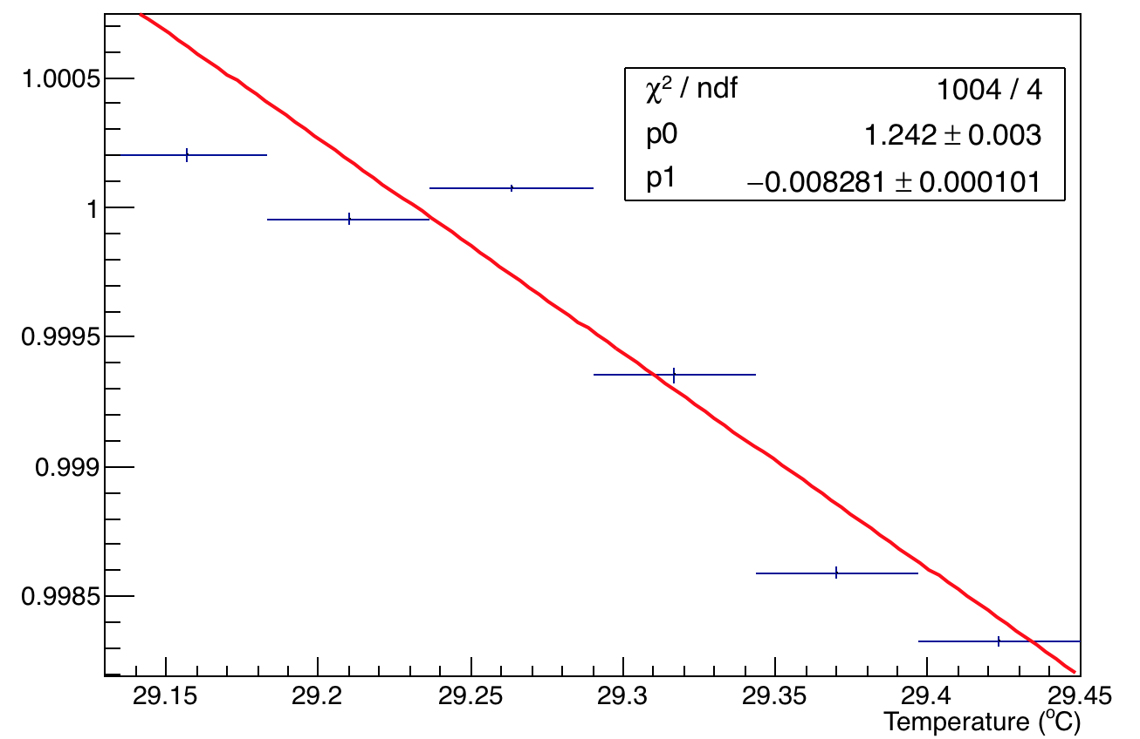
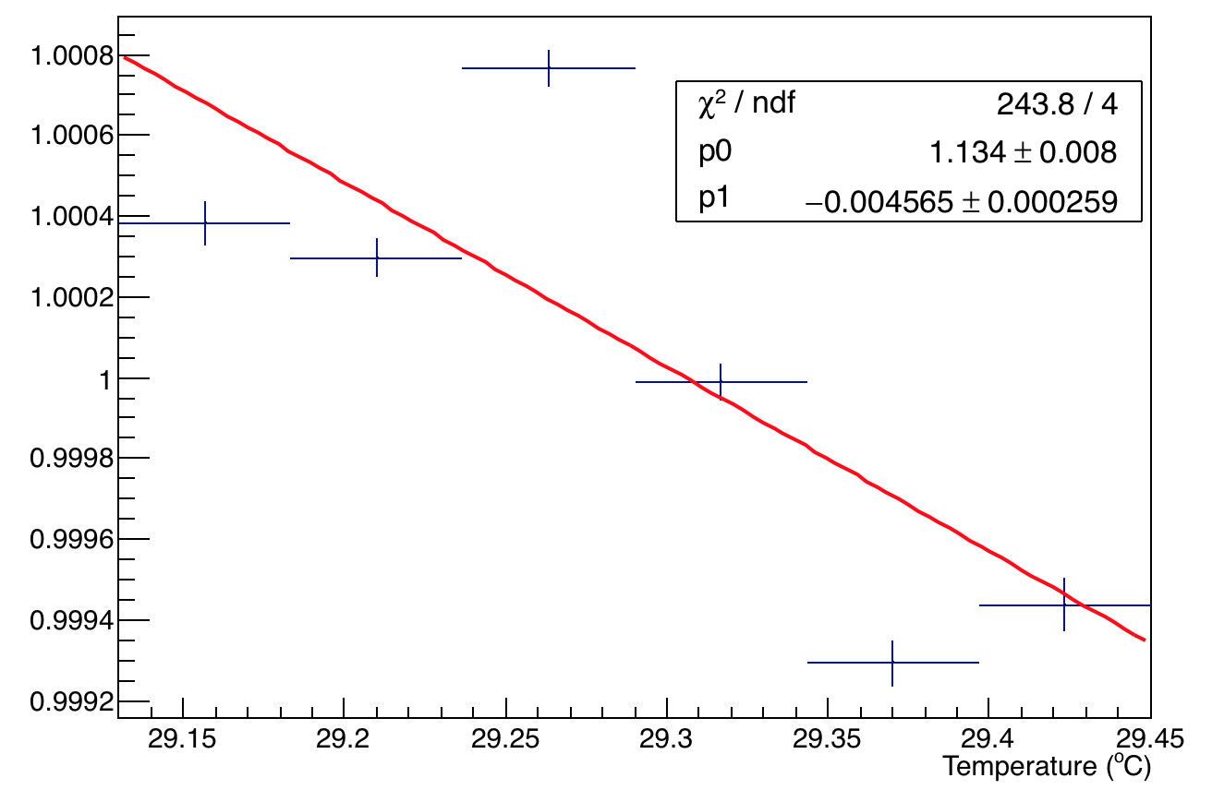
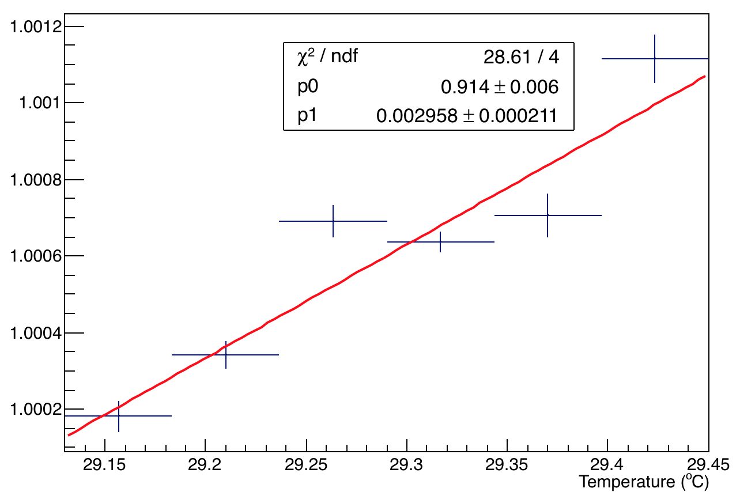
Channel 24 – Variation with temp
A1
A2
Run 18413
A2:A1

Slide 15
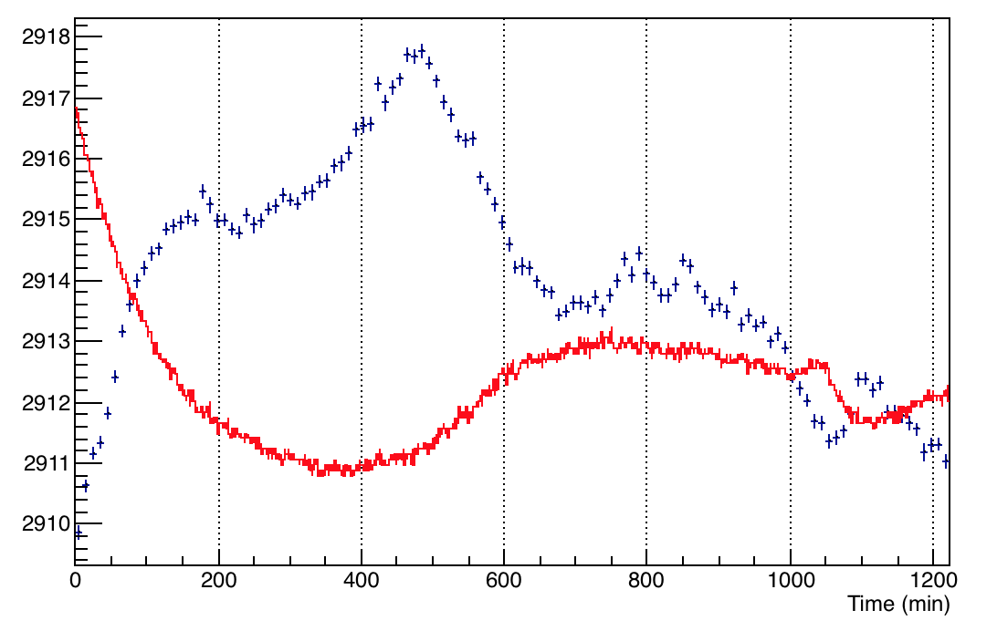
Temp dependence on A1 – Channel 23
Run 18422
Channel 23, Amplitude 1
-- 29.8
-- 29.7
-- 29.6
--29.5
--29.4
--29.3
--29.2
--29.1
Temperature (ºC)
Amp 1

Slide 16
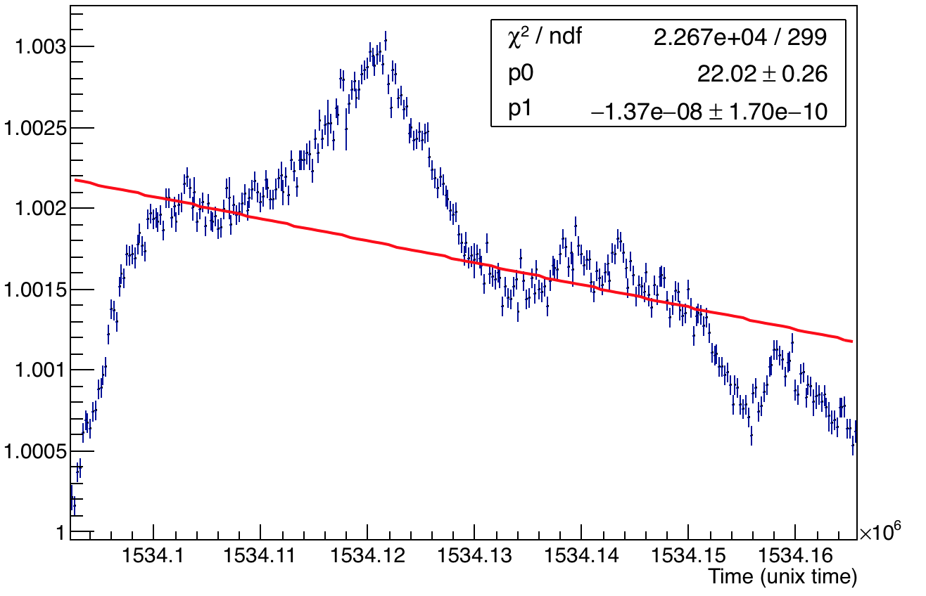
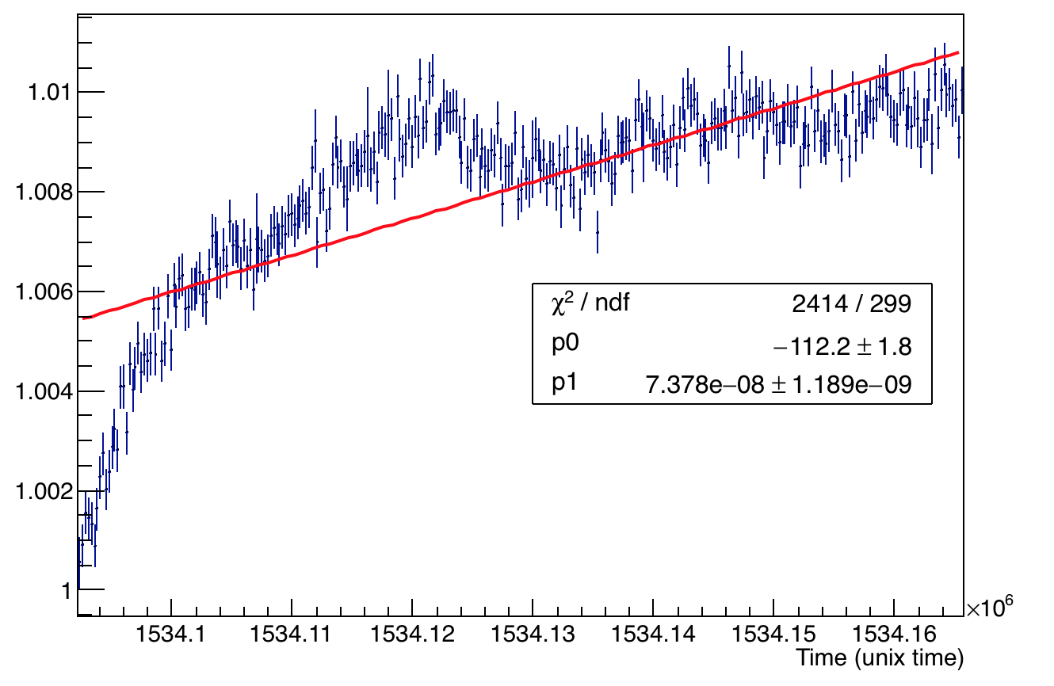
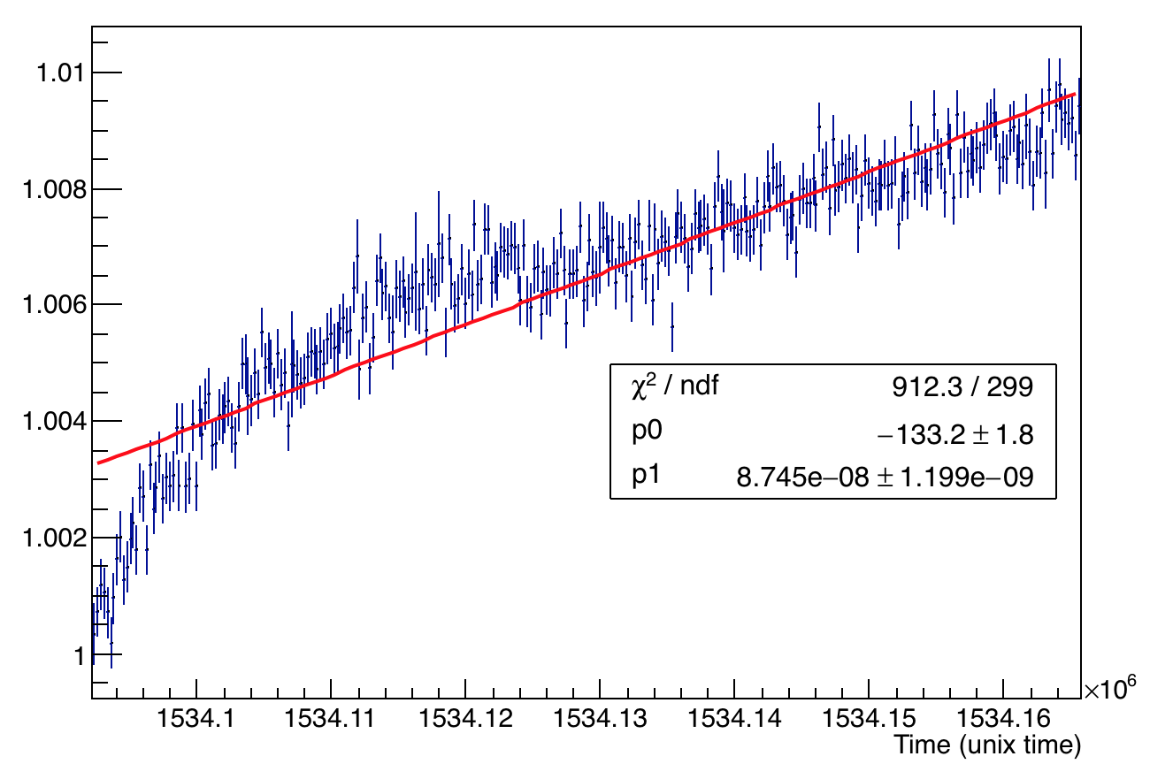
Channel 23 – Amplitudes
A1
A2
Run 18422
A2:A1

Slide 17
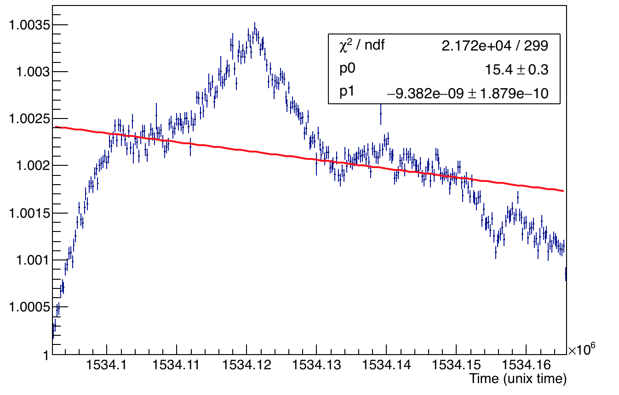
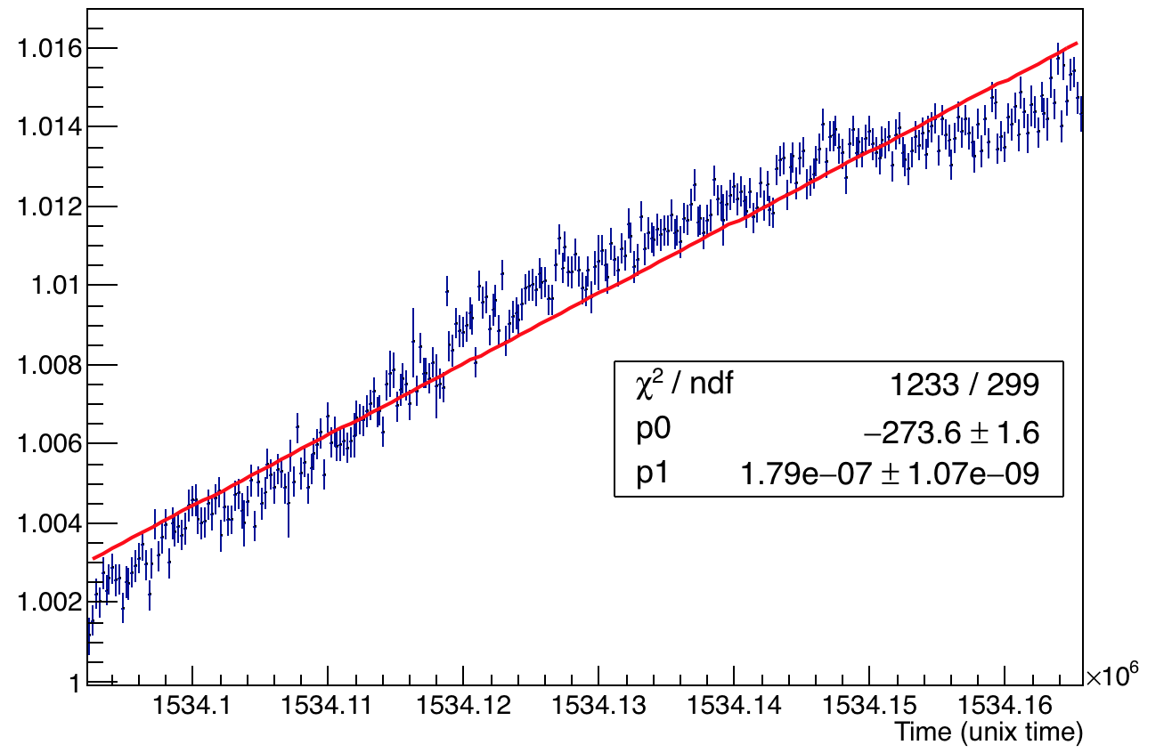
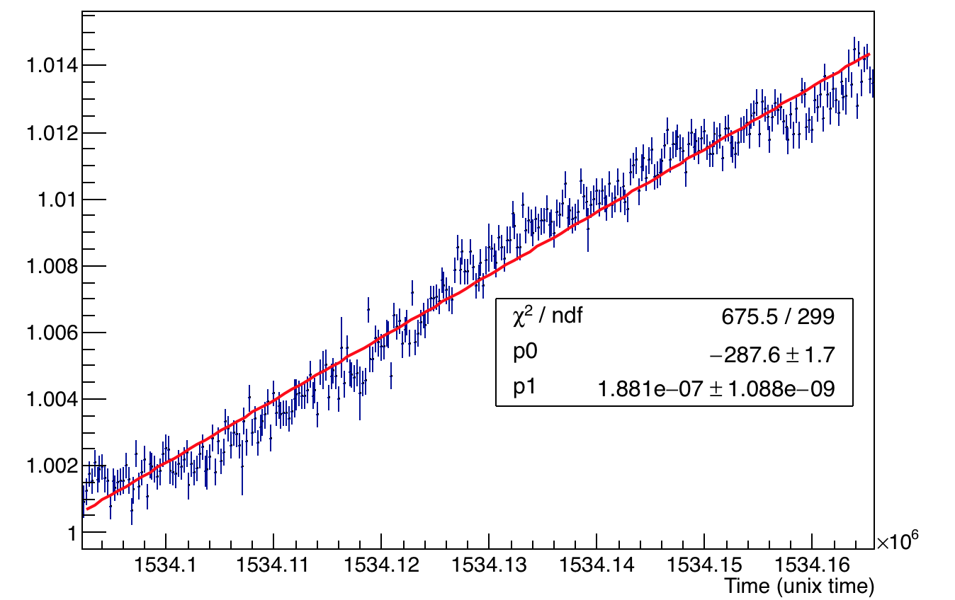
Channel 24 - amplitudes
A1
A2
Run 18422
A2:A1

Slide 18
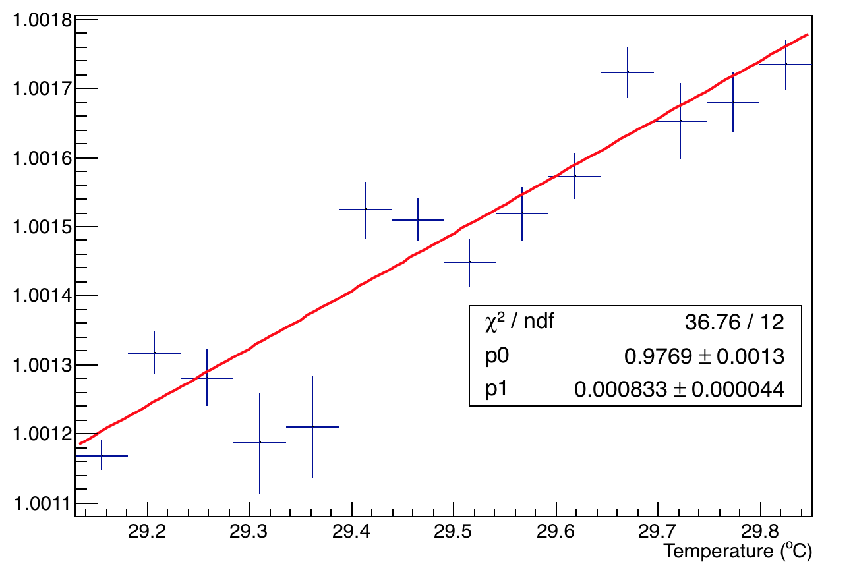
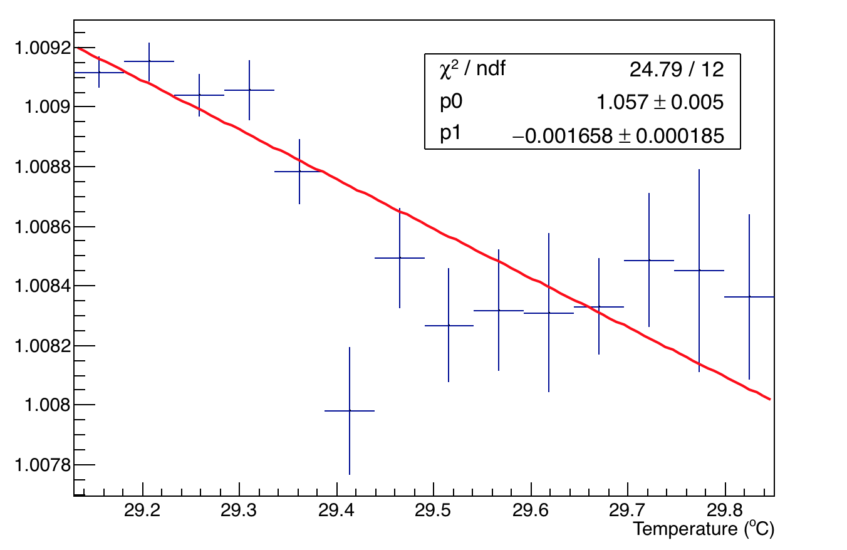
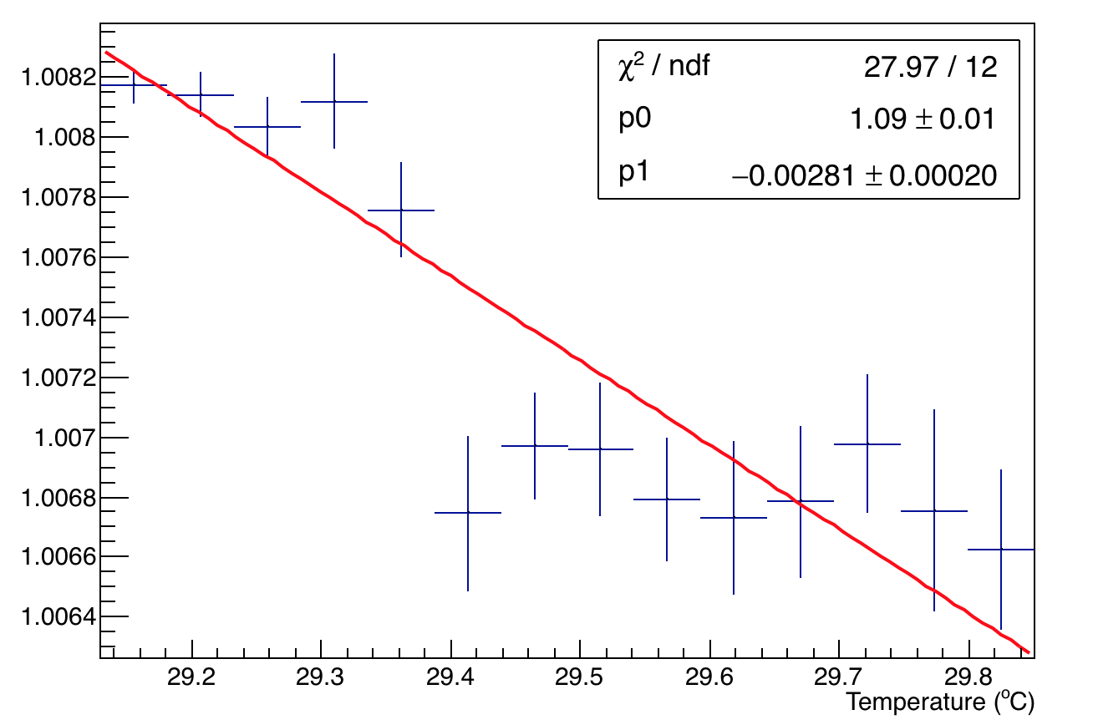
Channel 23 – Variation with temp
A1
A2
Run 18422
A2:A1

Slide 19
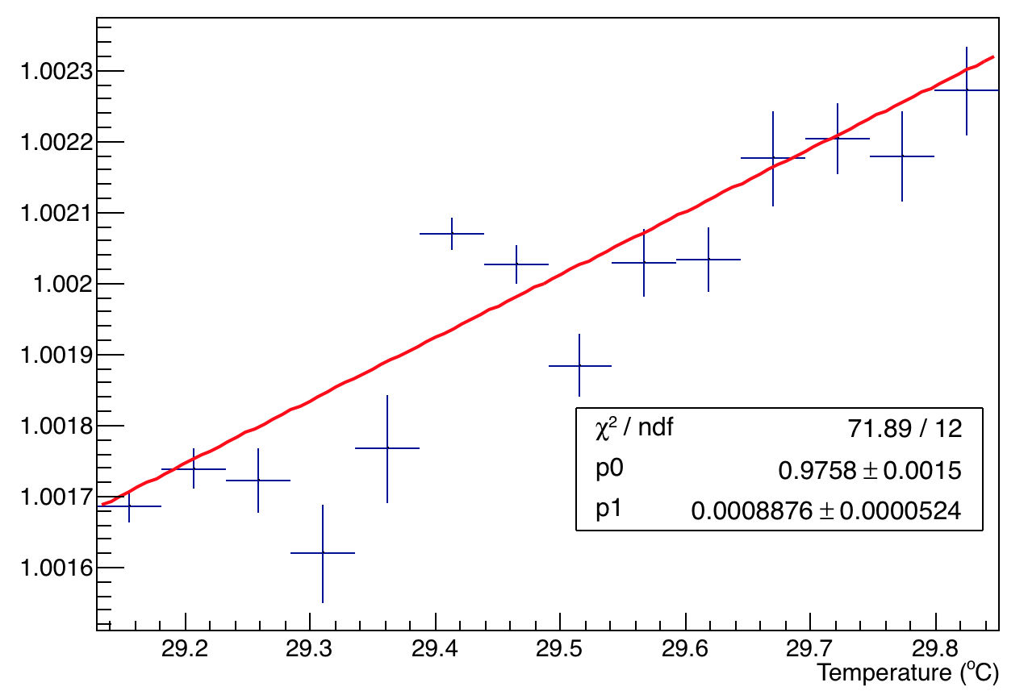
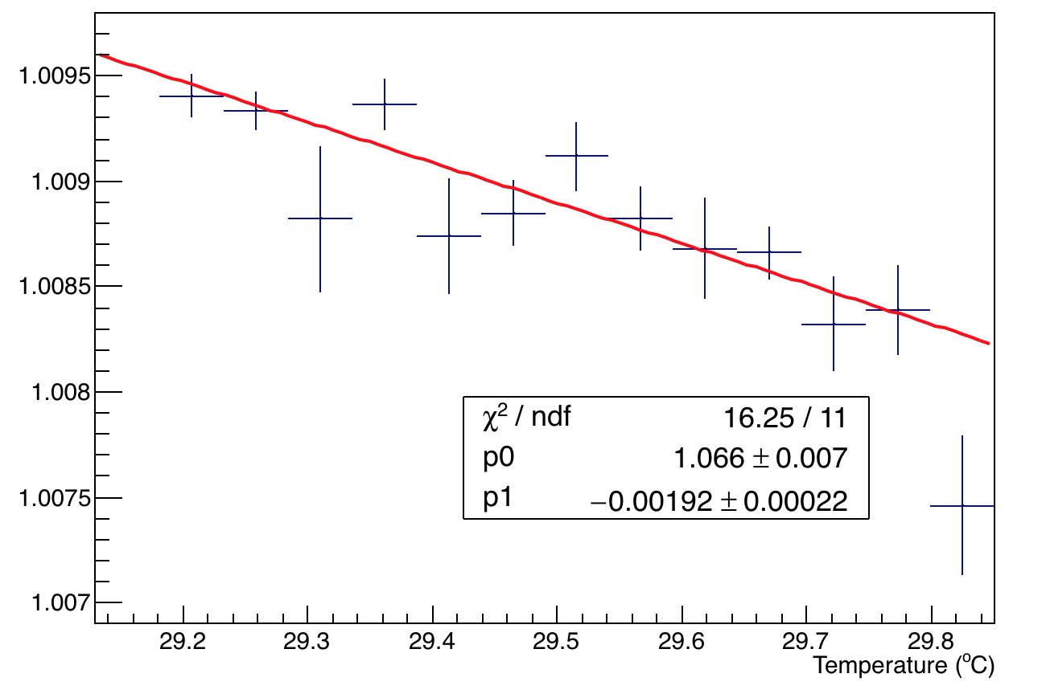
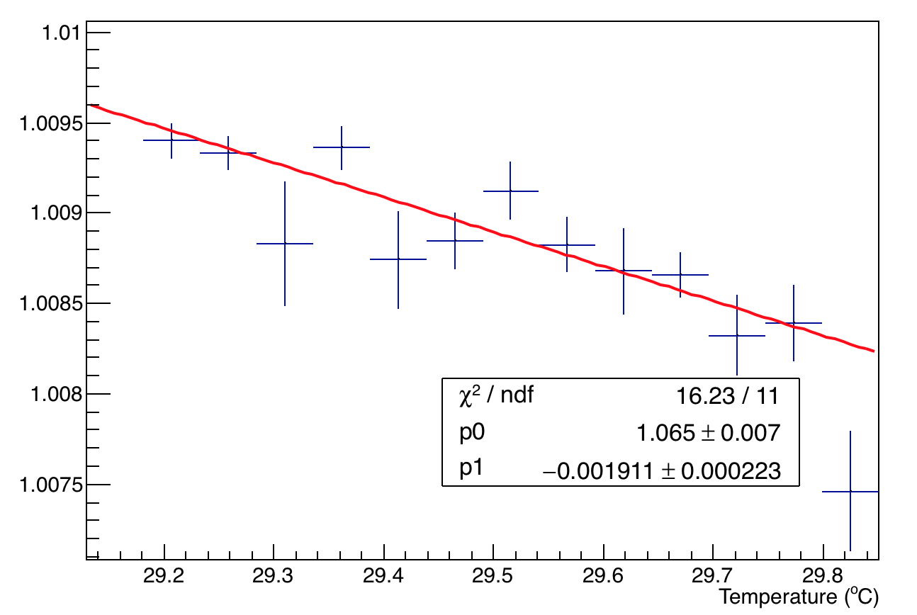
Channel 24 – Variation with temp
A1
A2
Run 18422
A2:A1

